Slide 1
Syllabus
Fiber optics introduction, optical fiber as a dielectric wave guide (Discussion + Video)
Total internal reflection, acceptance angle, numerical aperture, relative refractive index, V-Number
Step index and graded index fibers
losses associated with optical fibers
Applications of optical fibers

Slide 2
Modes and Materials
The term mode refers to mathematical and physical descriptions of the propagation of energy through a medium. A fiber can provide a path for one light ray or hundreds of thousands of light rays.
Since optical fiber is a waveguide, light can propagate in a number of modes
If a fiber is of large diameter, light entering at different angles will excite different modes while narrow fiber may only excite one mode
Multimode propagation will cause dispersion, which results in the spreading of pulses and limits the usable bandwidth
Single-mode fiber has much less dispersion but is more expensive to produce. Its small size, together with the fact that its numerical aperture is smaller than that of multimode fiber, makes it more difficult to couple to light sources

Slide 3
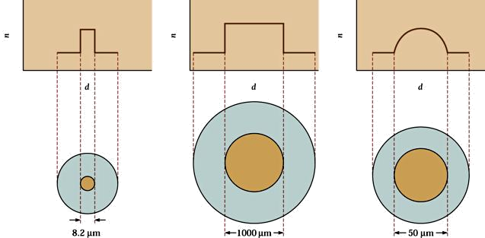
Fiber Classification
Based on mode the fiber can be classified into two types:
Single Mode Fiber
Multimode Fiber.
Based on index profile a fiber can be again classified into two types.
Step index and
Graded index.
Thus in totality we have the following three classification of the fiber.
Multimode step index fiber (MMSIF).
Multimode graded index fiber (MMGIF).
Single mode step index fiber (SMSIF).
Till now the types of fiber described, are the step-index fibers because the index of refraction changes radically between the core and the cladding
Graded-index fiber is a multimode fiber, but the index of refraction gradually decreases away from the center of the core
Graded-index fiber has less dispersion than a multimode step-index fiber

Slide 4
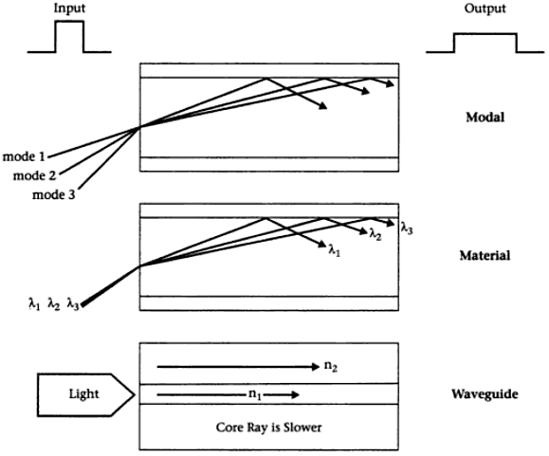
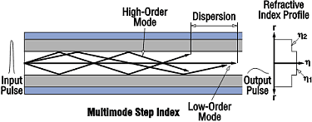
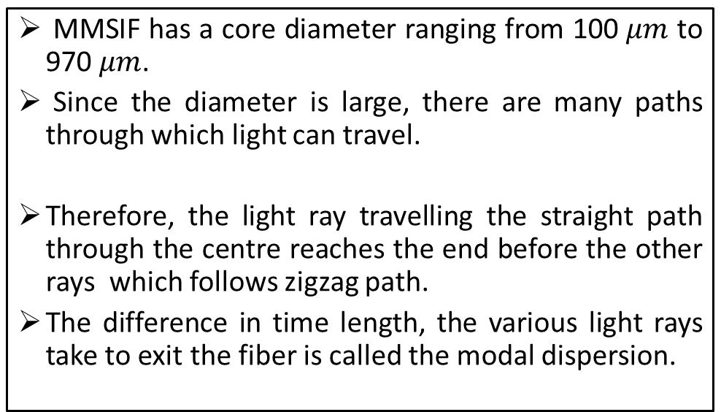
Multimode Step Index Fibers (MMSIF)
MMSIF has a core diameter ranging from 100 $μm$ to 970 $μm$.
Since the diameter is large, there are many paths through which light can travel.
Therefore, the light ray travelling the straight path through the centre reaches the end before the other rays which follows zigzag path.
The difference in time length, the various light rays take to exit the fiber is called the modal dispersion.
Dispersions

Slide 5
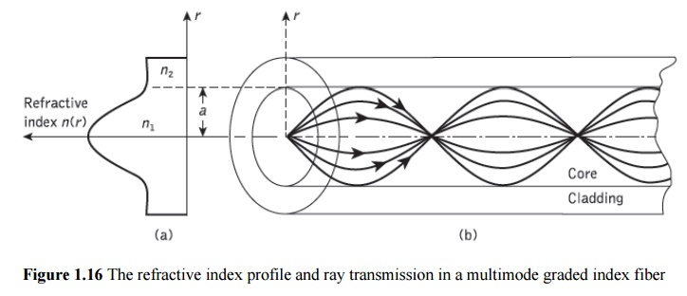
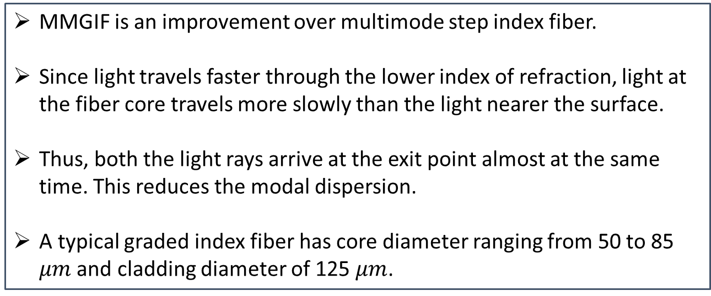
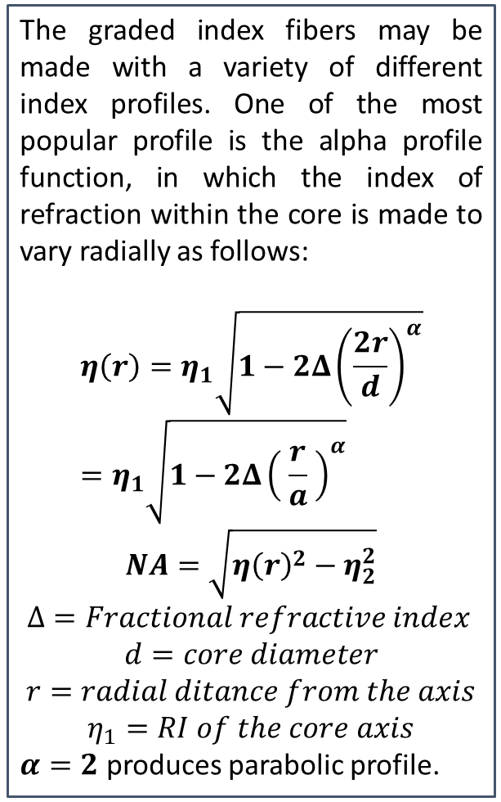


Multimode Graded Index Fibers (MMGIF)
MMGIF is an improvement over multimode step index fiber.
Since light travels faster through the lower index of refraction, light at the fiber core travels more slowly than the light nearer the surface.
Thus, both the light rays arrive at the exit point almost at the same time. This reduces the modal dispersion.
A typical graded index fiber has core diameter ranging from 50 to 85 $μm$ and cladding diameter of 125 $μm$.
The graded index fibers may be made with a variety of different index profiles. One of the most popular profile is the alpha profile function, in which the index of refraction within the core is made to vary radially as follows:
$$η\left(r\right)=η_{1}\sqrt{1−2Δ{\left(\frac{2r}{d}\right)}^{α}}=η_{1}\sqrt{1−2Δ{\left( \frac{r}{a} \right)}^{α}}$$
$$NA=\sqrt{{η\left(r\right)}^{2}−η_{2}^{2}}$$
$Δ=Fractional refractive index$
$$d=core diameter$$
$$r=radial ditance from the axis$$
$$η_{1}=RI of the core axis$$
$α=2$ produces parabolic profile.
$$η_{2}$$
$$η_{1}(r)$$

Slide 6
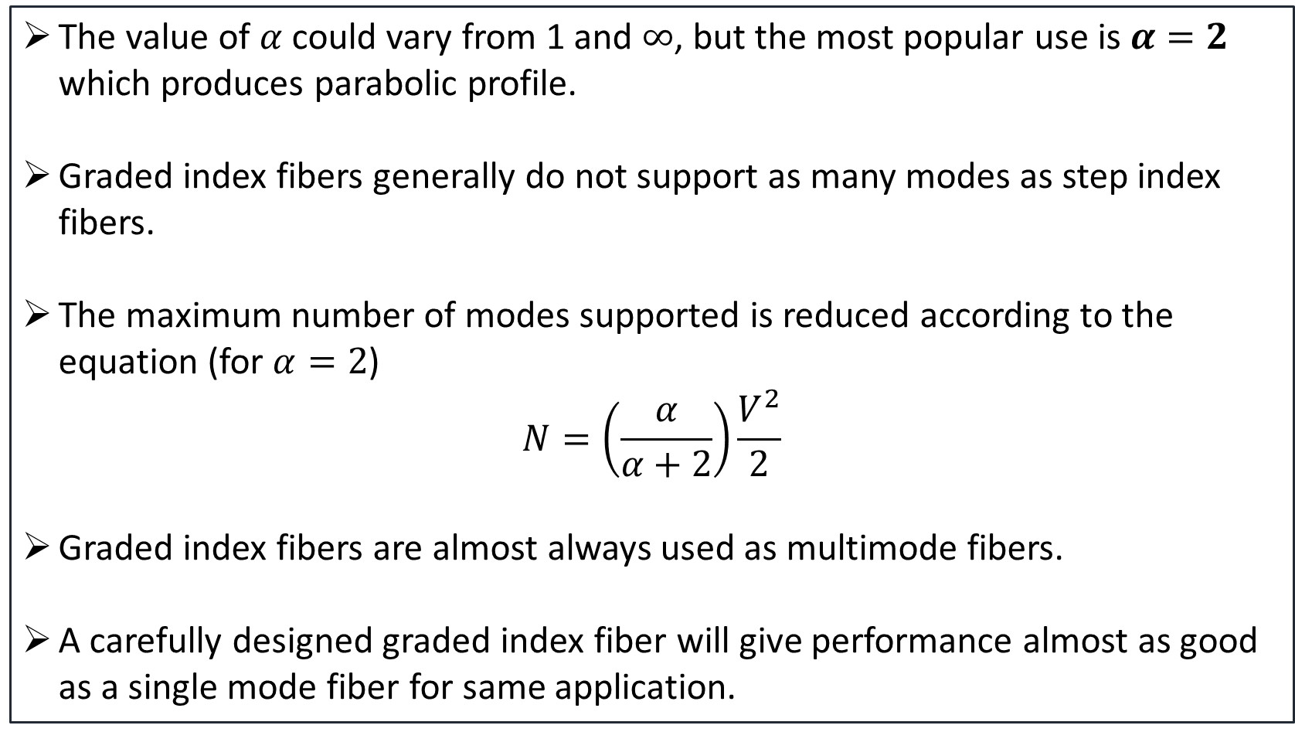
Multimode Graded Index Fibers (MMGIF) Mode Support
The value of $α$ could vary from 1 and $∞$, but the most popular use is $α=2$ which produces parabolic profile.
Graded index fibers generally do not support as many modes as step index fibers.
The maximum number of modes supported is reduced according to the equation (for $α=2$)
$$N=\left(\frac{α}{α+2}\right)\frac{V^{2}}{2}$$
Graded index fibers are almost always used as multimode fibers.
A carefully designed graded index fiber will give performance almost as good as a single mode fiber for same application.

Slide 7
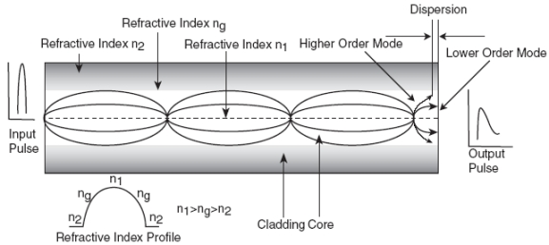
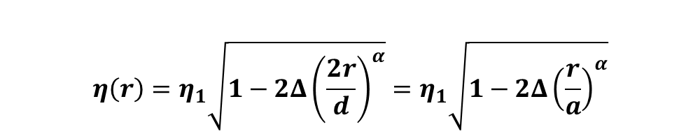
Index Profile (MMGIF)
$$η\left(r\right)=η_{1}\sqrt{1−2Δ{\left(\frac{2r}{d}\right)}^{α}}=η_{1}\sqrt{1−2Δ{\left(\frac{r}{a}\right)}^{α}}$$

Slide 8
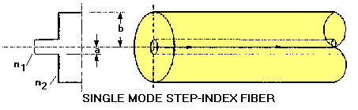
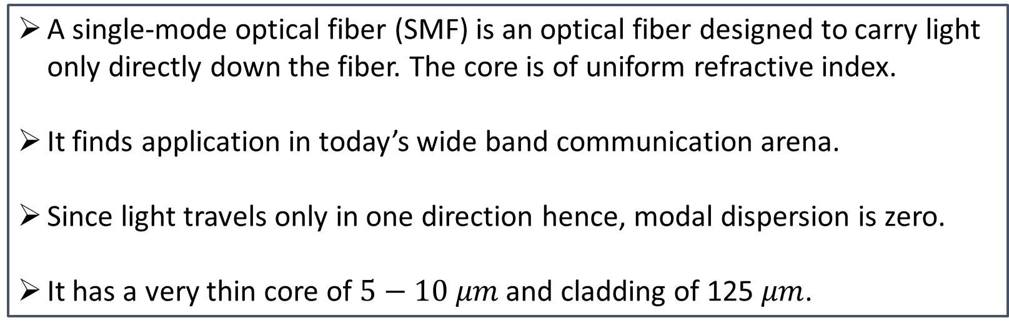
Single-mode Step Index Fiber (SMSIF)
A single-mode optical fiber (SMF) is an optical fiber designed to carry light only directly down the fiber. The core is of uniform refractive index.
It finds application in today’s wide band communication arena.
Since light travels only in one direction hence, modal dispersion is zero.
It has a very thin core of $5−10 μm$ and cladding of 125 $μm$.

Slide 9
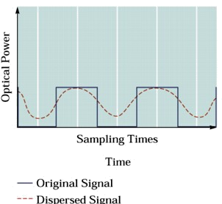
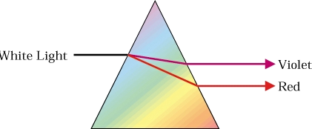
Dispersion
Dispersion in fiber optics results from the fact that in multimode propagation, the signal travels faster in some modes than it would in others
Single-mode fibers are relatively free from dispersion except for intra-modal dispersion
Graded-index fibers reduce dispersion by taking advantage of higher-order modes
One form of intra-modal dispersion is called material dispersion because it depends upon the material of the core
Another form of dispersion is called waveguide dispersion
Dispersion increases with the bandwidth of the light source

